Slide 1
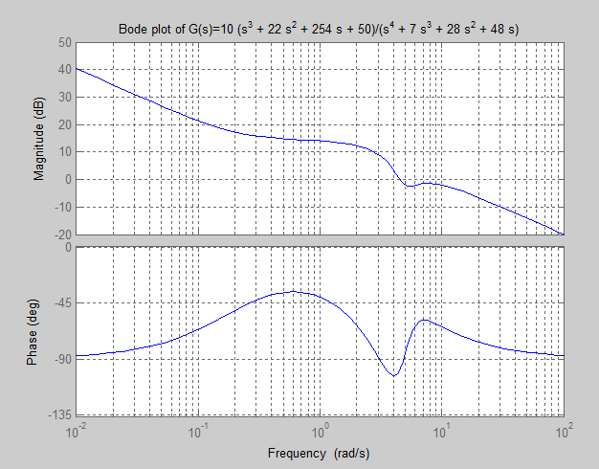
Bode Phase Plots
Professor Walter W. Olson
Department of Mechanical, Industrial and Manufacturing Engineering
University of Toledo

Slide 2
Outline of Today’s Lecture
Review
Frequency Response
Reading the Bode Plot
Computing Logarithms of |G(s)|
Bode Magnitude Plot Construction
Phase
Phase Computations
Full Bode Plot
System Identification
Using Bode Plots for System Identification

Slide 3
Frequency Response
General form of linear time invariant (LTI) system was previously expressed as
We now want to examine the case where the input is sinusoidal. The
response of the system is termed its frequency response.

Slide 4
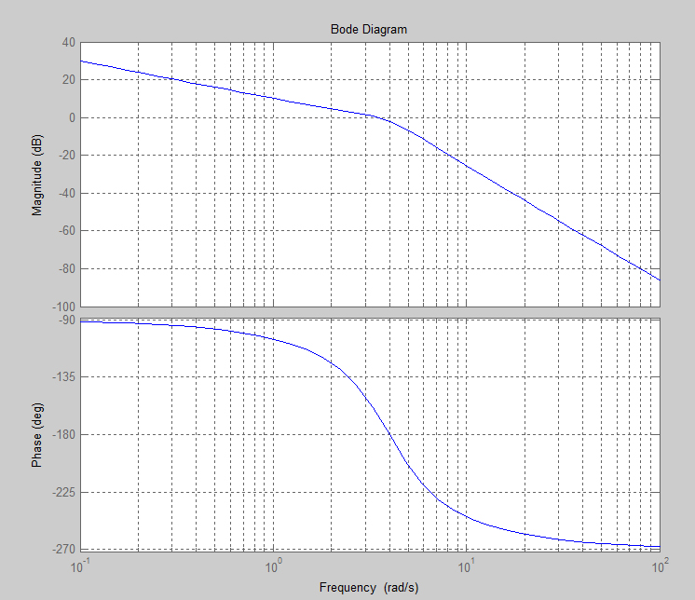
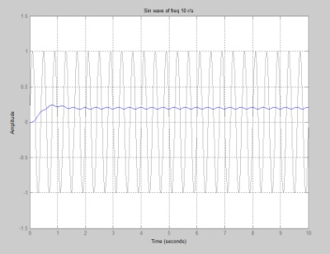
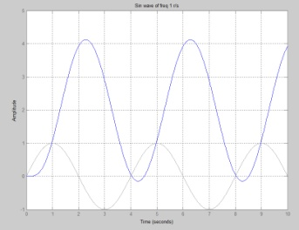
Reading the Bode Plot
Amplifies
Attenuates
Input
Response
The magnitude is in decibels
decade
also, cycle
Note: The scale for ω is logarithmic

Slide 5
What is a decibel?
The decibel (dB) is a logarithmic unit that indicates the ratio of a physical quantity relative to a specified or implied reference level. A ratio in decibels is ten times the logarithm to base 10 of the ratio of two power quantities.
(IEEE Standard 100 Dictionary of IEEE Standards Terms, Seventh Edition, The Institute of Electrical and Electronics Engineering, New York, 2000; ISBN 0-7381-2601-2; page 288)
Because decibels is traditionally used measure of power, the decibel value of a magnitude, M, is expressed as 20 Log₁₀(M)
20 Log₁₀(1)=0 … implies there is neither amplification or attenuation
20 Log₁₀(100)= 40 decibels … implies that the signal has been amplified 100 times from its original value
20 Log₁₀(0.01)= -40 decibels … implies that the signal has been attenuated to 1/100 of its original value

Slide 6
Computing Logarithms of G(s)
Since this does not vary with the frequency it a constant that will be added to all of the other factors when combined and has the effect of moving the complete plot up or down
When this is plotted on a semilog graph (ω the abscissa) this
is a straight line with a slope of 20p (p is negative if the s^{p} term is in the denominator of G(s)) … without out any other terms it would pass through the point (w,MdB) = (1,0)

Slide 7
Computing Logarithms of G(s)
a is called the break frequency for this factor
For frequencies of less than a rad/sec, this is plotted as a horizontal line at the level of 20Log₁₀ a,
For frequencies greater than a rad/sec, this is plotted as a line with a slope of ± 20 dB/decade, the sign determined by position in G(s)

Slide 8
Computing Logarithms of G(s)
w_{n} is called the break frequency for this factor
For frequencies of less than w_{n} rad/sec, this is plotted as a horizontal line at the level of 40Log₁₀ w_{n},
For frequencies greater than w_{n} rad/sec, this is plotted as a line with a slope of ± 40 dB/decade, the sign determined by position in G(s)

Slide 9
Bode Plot Construction
When constructing Bode plots, there is no need to draw the curves for each factor: this was done to show you where the parts came from.
The best way to construct a Bode plot is to first make a table of the critical frequencies and record that action to be taken at that frequency.
You want to start at least one decade below the smallest break frequency and end at least one decade above the last break frequency. This will determine how semilog cycles you will need for the graph paper.
This will be shown by the following example.

Slide 10
Example
Plot the Bode magnitude plot of
Break Frequency | Factor | Effect | Cum value | Cum Slope dB/dec
0.01 | K=10 | 20Log₁₀(10)=20 | 20 | …
0.01 | s | Line -20db/dec Thru (1,0) | 20-slope for two decades (40) =60 | -20
0.2 | s+0.2 | +20Log₁₀(.2)= -13.98 | 60+6.02=46.02 | 0
3 | s+3 | -20Log₁₀(3)= -9.54 | 46.02-9.54= 36.48 | -20
4 | s²+4s+16 | -40Log₁₀(4)= - 24.08 | 36.48- 24.08= 12.4 | -60
5 | s²+2s+25 | +40Log₁₀(5)= 27.96 | 32.4+27.96= 40.36 | -20

Slide 11
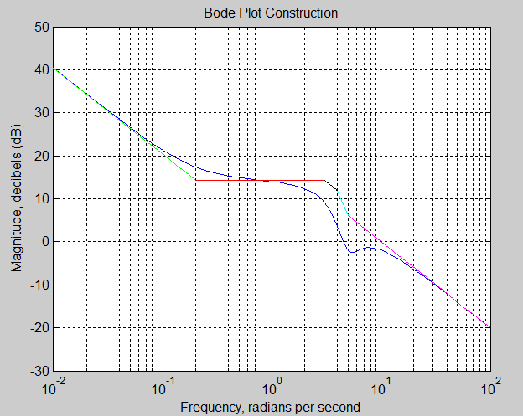
Example
Constructed Bode
Actual Bode

Slide 12
Phase
For a sinusoidal input, phase represents the lag of the system or, alternatively, the processing time of the system to produce an output from the input
Phase is measured as an angle
A cycle of the input is consider to take 2π radians or 360 degrees
Phase is the angular distance it takes for the output to represent the input
Thus it is normal that as the frequency increases that the phase also increase
In the case where the phase exceeds 180 degrees, the output appears to “lead” the input. This is particularly evident in the range of 270 to 360 degrees.

Slide 13
Phase
As with magnitude there are 4 factors to consider which can be added together for the total phase angle.
We will consider, in turn,
The sign will be positive if the factor is in the numerator and
negative if the factor is in the denominator

Slide 14
Phase Computations

Slide 15
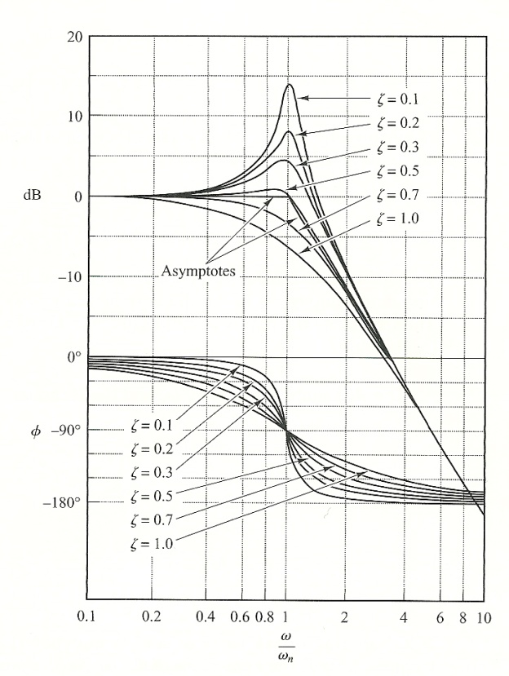
Phase Computations

Slide 16
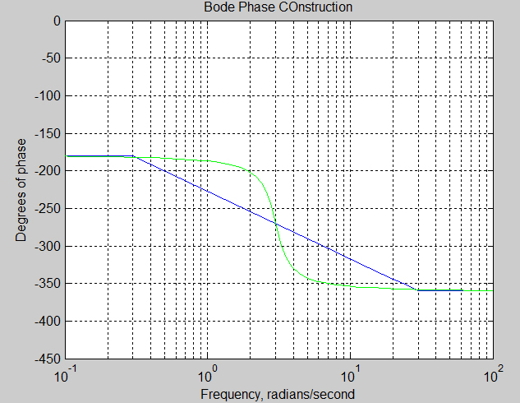
Example
Plot the Bode Phase Plot for

Slide 17
Example
Plot the Bode Phase Plot for
Again a table is useful:
Frequency | Factor | ω_{n} | ζ | Effect | Cum Value | Cum Slope
0 | s⁻¹ |  |  | constant -90 | -90 | -
0.02 | s+0.2 |  |  | break up at 45/dec |  | 45/dec
0.3 | s+3 |  |  | Break down at -45/dec |  | 0
0.4 |  | 4 | 0.5 | Break down at -90/dec |  | -90/dec
0.5 |  | 5 | 0.2 | Break up at 90/dec |  | 0
2 | s+0.2 |  |  | take out 45/dec |  | -45/dec
30 | s+3 |  |  | take out -45/dec |  | 0
40 |  |  |  | take out -90/dec |  | 90/dec
50 |  |  |  | take out 90/dec |  | 0
 | total exponent |  |  | 3-4=-1 >> -90 | -90

Slide 18
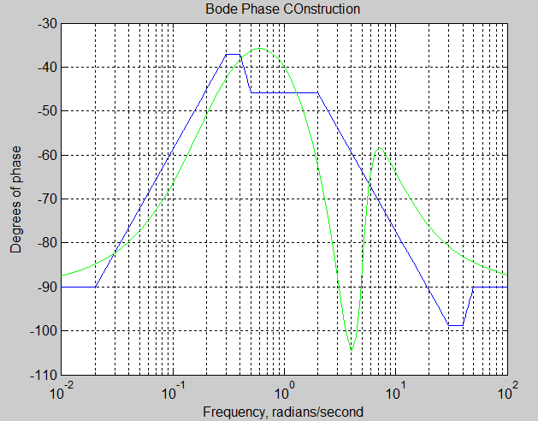
Example
Asymptotic Bode Phase
Actual Bode Phase

Slide 19
Full Bode Plot
Constructed Bode
Actual Bode
Asymptotic Bode Phase
Actual Bode Phase

Slide 20
Matlab Command bode(sys)

Slide 21
System Identification
It is not unusual for a field engineer to be shown a piece of equipment and then asked if he can put a control system on it or replace the control system for which there are no parts.
The task of determining how an unknown structure responds is called “System Identification”.
To identify a system, there are many tools are your disposal
First and foremost, what should the system structure look like?
Motors are often first order transfer functions ( ) which you then attempt to identify the constants
Perform step tests and see what the response looks like
Perform tests with sinusoidal outputs and use the Bode plot to identify the system
Apply statistical/time series methods such as ARMAX and RELS

Slide 22
Using Bode Plots for System Identification
The overall order of the system will be the high frequency phase divided by 90 degrees
The exponent of the “s” term will be the slope on the magnitude plot at the lowest frequency divided by 20
Alternatively, the exponent of “s” is the lowest frequency phase divided by 90 degrees.
The system gain constant (K_{t}) in dB will be the height value at the extension of the “s” term line on the magnitude plot to where it crosses1 rps
Starting from the left (the lowest frequency) on the magnitude plot, determine the structural components using the change in slopes in increments of 20 degrees either up or down
Then by using the intersection of the lines at those places match to the test curve, determine the break frequencies
Write the transfer function in the form

Slide 23
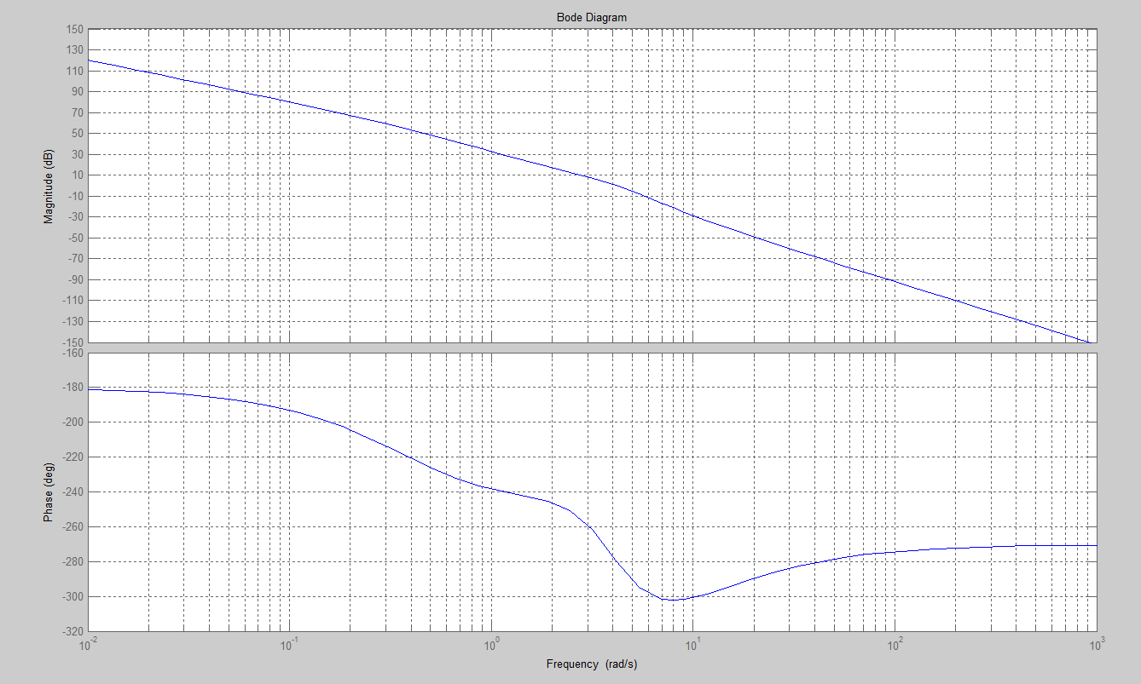
Example
-40 dB/dec
20 dB/dec
40 dB/dec
K_{t}=35 dB
60 dB/dec
-60 dB/dec
80 dB/dec
-40 dB/dec
-80 dB/dec
-40 dB/dec
0.52
2.2
4
20
exp of s = -2
overall order =3

Slide 24
Example
-40 dB/dec
-60 dB/dec
K_{t}=35 dB
-40 dB/dec
-80 dB/dec
-40 dB/dec
0.52
2.2
4
20
exp of s = -2
overall order =-3

Slide 25
Example
-40 dB/dec
-60 dB/dec
K_{t}=35 dB
-40 dB/dec
-80 dB/dec
-60 dB/dec
-40 dB/dec
0.52
2.2
4
20
exp of s = -2
overall order =-3

Slide 26
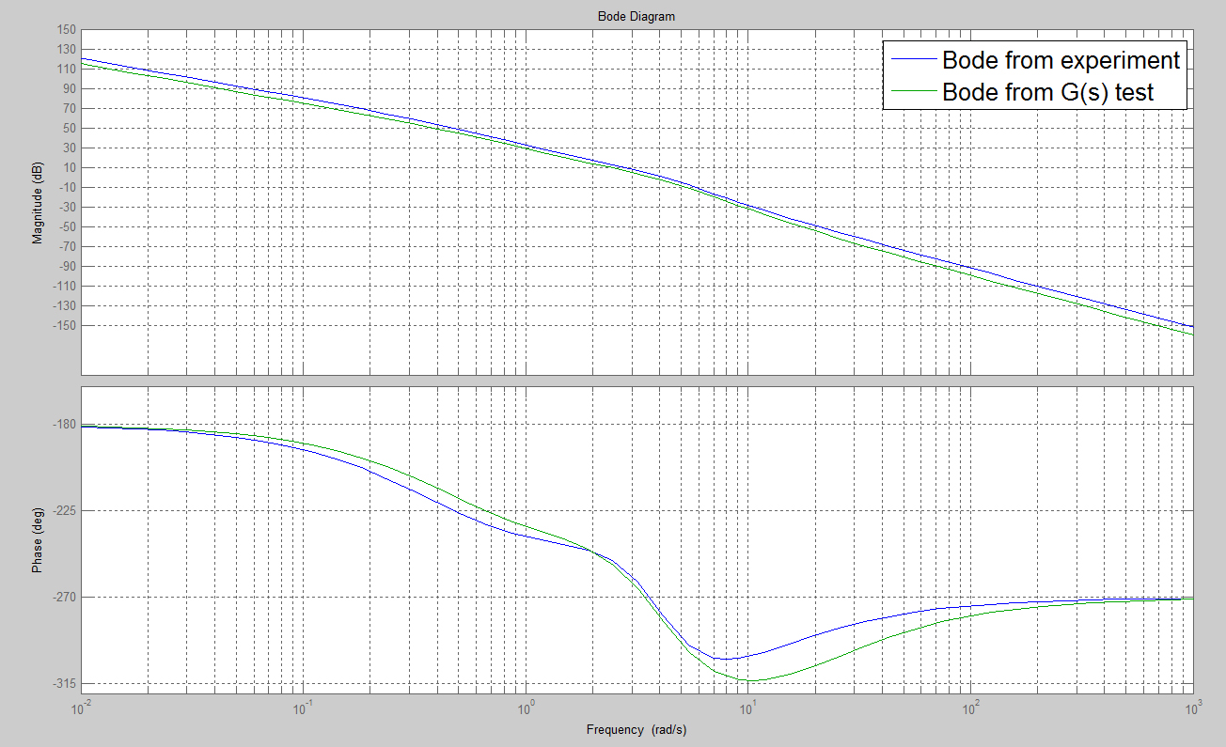
Example

Slide 27
Summary
Phase
For a sinusoidal input, phase represents the lag of the system or, alternatively, the processing time of the system to produce an output from the input
Phase Computations
Full Bode Plot
System Identification
The task of determining how an unknown structure responds is called “System Identification”.
Using Bode Plots for System Identification
Next Class: Laplace Transforms

